Slide 1
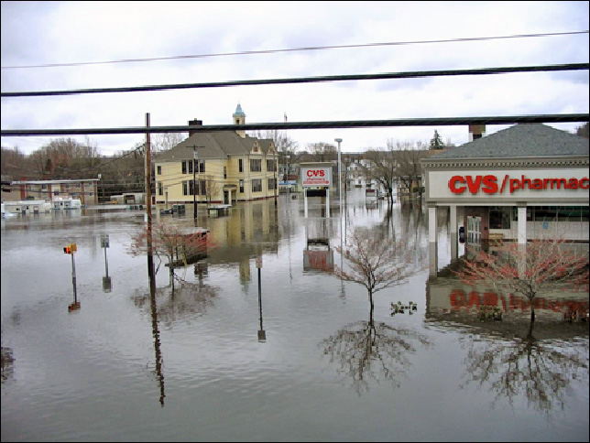
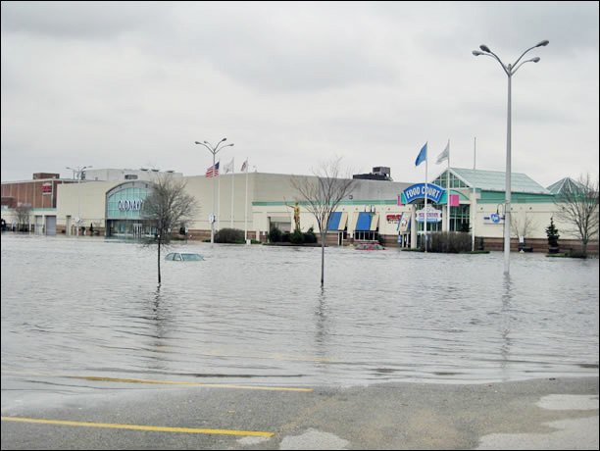
Challenge – Predict Street Flooding &Contamination “Hack That Flood”
Two part project: A smartphone application that predicts storm water runoff by integrating real-time NWS with DOT and GIS data into an easy-to-use download; plus a remote floating sensor platform that collects and transmits selected marine conditions.
Save lives by directing people away from flooded streets and contamination!
Notes:
Rhode Island is the Ocean State with approximately 400 miles of coastline and an elevation that is at or near sea level in most areas. Rhode Island is particularly vulnerable to coastal hazards such as flooding and storm
surge. With more extremes of weather, we could have more storms with more rainfall. In a storm emergency you might get a regional alert for southeast Providence. But you get no information about imminent flooding of streets. This project has two (2) parts. One is a smartphone application and the second is a solar powered, multi-sensor buoy like a spacecraft only floating in a marina or estuary. Suppose you could predict street flooding with a simple smart phone application? Suppose you designed and built this integrated sensor platform that recorded and transmitted hydrological data like salinity, oil and gasoline contamination, wave motion, and more? That’s the Challenge. I’m using ‘hack’ as an ambitransitive verb to mean ‘to work on a computer programming or computer software problem’, or ‘to solve a computer problem quickly’.

Slide 2
Providence Journal Editorial 25 August 2014
By Patricia Jedele, VP Conservation Law Foundation. CLF is an advocate for clean water, oceans, energy and communities.
Notes:
This is the article that got me thinking about solving the problem of monitoring ‘sick’ ponds and predicting flood areas for people driving cars. Patricia Jedele, Vice President of Conservation Law Foundation, summed up her concern about how a few inches of rain in one area can create chaos in another because urban watersheds funnel water to populated areas. Runoff creates flooding but I believe it’s predictable based on knowledge of existing infrastructure, hydraulic engineering and known flood plains. In this editorial from the Providence Journal on August 25, 2014, Ms. Jedele identifies one such pond that is ‘sick’; I’m sure many other such ponds are identified by municipal reporting but are not in a database accessible by homeowners and anyone with a smart phone and internet connection. As a spinoff project, suppose you drop a solar powered ‘buoy’ or remote sensor into a pond; this buoy would transmit salt and oil concentrations to a database and displayed in this mobile app.

Slide 3
The Problems and Challenges
From a storm water management perspective:
More paved-over areas (parking lots, streets, sidewalks) channel water faster.
More garbage, gasoline, oil, salt and fecal matter channeled to ponds, streams, rivers and ocean.
More debris blocks storm drains increasing channel flow to alternate routes.
No small, inexpensive, multi-sensor floating platform to record marine conditions.
Result: contaminated flash, river, and coastal flooding
Read ProJo article: 10 September 2015
From a user perspective:
No mobile, easy-to-use, inexpensive, real-time prediction smartphone app for flood conditions, ‘first flush’ areas, etc., in Rhode Island.
Innovyze does provide InfoWorks - very complicated, very expensive workstation models for utility company command and control rooms. http://www.innovyze.com
Your solution will identify flooded streets and contaminated storm water runoff!
Notes:
I’ve considered some of many problems associated with storm water management like the effect of paved impermeable surfaces and people safety. Towns, cities and state agencies try to channel, store and clean storm water runoff because it can contain toxic chemicals, biological contaminants, and a lot of junk. But it doesn’t always go where you expect it. That’s a problem. Like the story in the previous page, flooding can cause minor inconvenience or endanger life when someone tries to drive through a flooded street. As far as I know, there is no mobile application that integrates meteorological, infrastructure, and historic data that’s easy to use and inexpensive.

Slide 4
The Challenges
Develop a smartphone application…
And a remote, solar powered, integrated floating sensor platform…
That integrates GIS and real time National Weather Service RSS feeds…
With data about historic known flood areas…
Using COTS software and data (open source SW)…
To calculate a probability of flooding and water conditions…
Along a user selected street track.
The key is to focus on a well-defined small set of parameters!
Notes:
Here is a statement that describes the project; it’s really a two-in-one project with the sensor platform data as an input into the mobile application. An Android platform is the target OS development platform since it has 58% of the US market share and has many open source free tools for imagery, expert systems, API development and documentation. Every effort should be made to use commercial off the shelf (COTS) software and hardware.

Slide 5
Notional Software Architecture
The notional architecture consists of four major inputs.
Really Simple Syndication (RSS) feeds from National Weather Service.
DOT knowledge
Remote sensor data
Geographic imagery
The expert system integrates data, algorithms and information.
And sends results to the smartphone client.
NOAA RSS Feed
GIS display
DOT knowledge database
Flood probability
Expert System
Smartphone application
Remote sensor data
Contaminant concentration
GIS database
Notes:
Here is a notional, first cut, at a software architecture that shows the major components. Each of these must be decomposed into subsystems, components and parts. Tools need to be selected for single OS-development. Here is a link for Android tools: Google Android: https://developer.android.com/sdk/index.html.

Slide 6
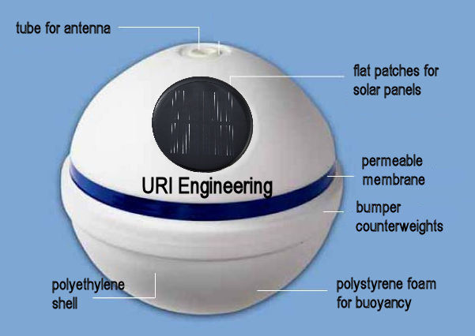
Remote Sensor Platform – Notional Design
Modified COTS mooring buoy.
Acts like a spacecraft ‘bus’ carrying sensors.
Solar powered internal rechargeable battery supply.
Membrane detects salt, oil or gasoline contaminants.
Accelerometer to measure wave action.
Waterproof outer shell.
Uses cellphone carrier to transmit data.
Notes:
This remote sensor, in itself, is a major project. It could be tethered in a marina or estuary. It has to have a rigid superstructure that withstands impact loads from rolling around in a saltwater environment. It needs transfusion membranes that allow salt, oil, and other contaminants to pass through it, process it, and send an indication of the presence of water, oil, or salt or other contamination to a central database. Hypothetically, it does this by measuring the electrical potential of the membrane when exposed to rain water, salt water, or water contaminated with solvents. The hypothesis is that these substances create a different electrical potential on the membrane. It’s made from a modified marine buoy that’s been split in half to allow electronics components to be mounted and sealed inside.

Slide 7
Notional Remote Floating Sensor Platform Architecture
Structure
Antennas (GPS / RF)
Power
Sensors
Electronics
Internal
Mount
Rechargeable
Battery Pack
Contaminant
Transponder
External
Elements
Accelerometer
Analyzer
Batteries
GPS
Adhesive
Wiring
Wiring
Connectors
Accelerometer
Counterweight
Filters
Connectors
Wiring
Signal processor
Connectors
Voltage Regulator
Transducer
Fasteners
Memory
Solar panels
Grommet
Ground plane
Salinity
Connectors
Notes:
Here is a notional, first cut, at a sensor platform architecture that shows the major subsystems. You have the structure, antennas (GPS and RF), power subsystem, contamination detector, and electronics. Each of these must be decomposed into components and parts.

Slide 8
Approach – Develop Smart Phone Application and Sensor Platform
Select local measurement areas for project.
Use Android OS platform (large US market share, good tools, etc.)
Determine server side and client functions, software.
Brice Loose to assist student team.
Develop plan for hardware/software/people resources, schedule, budget, etc.
Student Team. All others please submit recommendations in writing.
Collect input from RIDOT and utility services (National Grid).
Student Team with help from professionals.
Treat the storm water runoff as a problem in hydraulics engineering.
Create GIS street overlays and calculate elevation, latitude, longitude, locations.
Combine hydraulic model data with real-time meteorological (rainfall) predictions.
Requires collecting data from NOAA RSS weather feeds.
Track and transmit tidal flow, sensor data (heave, contam, etc.) to smartphone application.
Develop rules using expert system (CLIPS) to predict flood probability.
Notes:
The project would start with defining a geographic area under investigation – maybe a one mile square area that is prone to flooding. Or some area much smaller like the college campus. This project requires some civil and hydraulic engineering knowledge as well as some out reach to local DOT and DEM professionals. The project would need a mix of computer science and civil engineering students with skills in hydraulic engineering, rapid prototyping, Buzz Touch, and good social skills interviewing DOT and municipal people. Somehow this information gets overlaid onto a geo database like Google Earth. Of course, a GPS tracking capability will help simplify showing the user in relationship to surrounding area.

Slide 9
Benefits
Ability to design a mobile application architecture and UI.
Greater understanding of human influence on geology.
Greater understanding of existing RI infrastructure.
Greater understanding of state, municipal, and local roles in managing water quality, roads, etc.
Greater understanding of role of hydraulic engineering in Civil Engineering.
Develop methods for recording interviews, i. e., questionnaires.
Develop interview techniques (questionnaires) using both face-to-face and remote (FaceTime, Skype, etc.) interviews.
Notes:
The benefits for students are many. From an engineering perspective, they’ll learn about hydraulic engineering, smart phone apps using RSS feeds, expert systems and other SW development applications. So this project requires a blend of skills in computer science, civil engineering, and perhaps electrical engineering needed to develop the remote sensor. And they’ll learn about how municipalities manage waste water runoff. Plus, a better understanding of the human influence on geology and infrastructure.

Slide 10
Sample Notional Functional Analysis
Functions
Start application
Display geographic information
Display user location
Pan display
Zoom display
Store weather data
Input DOT data
Store DOT data
Show weather data
Show sensor data
Record and display user track
Calculate probability of street flooding
Show street flooding
Notes:
Here’s a notional high level systems engineering functional analysis of how a user might use the smartphone application.

Slide 11
Sample Notional Task Analysis Record and display user street track
User Actions
Locate ‘me’
Locate road
Zoom in
Locate start
Start ‘track’
Tap pt.1
Tap pt.2
Tap pt.3
Etc…
End ‘track’
Calculate p
Electronic Actions
Display user location
Track route taps
Get geo database
Get DOT / DEM data
Get NOAA RSS feed data
Display ‘tap’ route
Get elevation
Calculate elevation deltas
End route
Calculate user data
Display results
Notes:
Here’s a notional high level list of user actions and electronic (application, database, etc.) reaction called a task analysis based on the top level function ‘Record and display user street track’. On the left side are sample user actions; on the right are electronic actions. By electronic I mean accessing databases, calculating elevation deltas, tracking the geo database of points, tracking user inputs, etc. Called a systems engineering task analysis, it identifies the discrete actions that the system (user, user interface, mechanical, electrical) must perform to satisfy a function. This is one of the systems engineering tools you’ll need to use to understand the user interface and system architecture.

Slide 12
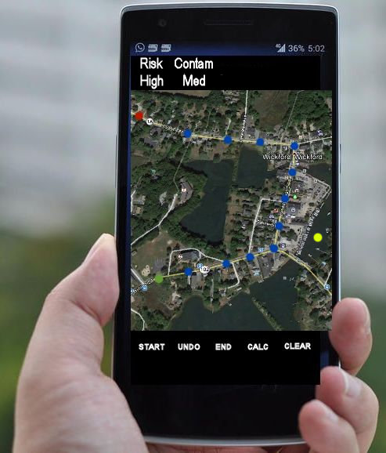
Notional ‘Hack The Flood’ display
Suggested Features:
Common functions (zoom, pan)
Message area
Auto locator - ‘You Are Here’
Search capability
Show user track
Show flood risk probability
Show weather forecast
Show contamination ‘hot spots’
Show functions
Notes:
Here’s a notional display of the Wickford area showing a map with user ‘tap’ points in blue along Rt. 102 and 1A. The user location is a red dot; the end point is a green dot. Essentially, the user is tracing a road path through the town of Wickford and wants to know the probability that the road is flooded. Messages such as prompts and progress and next actions are displayed in the message display field at the top; control buttons are shown at the bottom. About 5 -10 functions (buttons) can be displayed in this control area.

Slide 13
Skills, Roles and Responsibilities
Smartphone application skills
GIS knowledge, map overlays, digital elevation modeling
Database integration
Server software integration
Smartphone app building
Sensor Platform skills
Hands-on circuit board experience
Power requirements
RF / GPS antennas
Hardware / software integration
Sensor experience
Instrumentation
3D modeling / printing
CPE
CPE
Mobile GUI/ Smartphone App Engineer
GIS / Database Engineer
ELE
ELE
RF / Power Hardware Materials Engineer
Micro-processor Integration Engineer
Notes:
This diagrams shows the mix of student majors and skills for the two projects. Basically, the CPE students develop the smart phone applications and the ELE students develop the integrated remote sensor platform. The mix of skills is impressive – power systems, sensor data collection, database management, RF and GPS integration. The sensor project and data sets require inputs from the URI Graduate School of Oceanography.

Slide 14
Deliverables
Smartphone Application
Phase One
System / detail requirements
Functional analysis
Tradeoff studies
Notional architecture / diagrams
Tool selection
Prototype / demonstration
Interim report
Phase Two
Iterate design and demonstrate compliance to top level requirements
Concept demonstration
Final report
Remote Sensor Platform
Phase One
System / detail requirements
Functional analysis
Tradeoff studies
Notional architecture / schematics
Tool / material selection
Prototype / demonstration
Interim report
Phase Two
Iterate design and demonstrate compliance to top level requirements
Concept demonstration
Final report
Follow the ’45 minute rule’; if you’re stumped, then ask someone for help!
Notes:
There are two major phases to this project. The first few weeks are devoted to tradeoff studies, requirements development and functional analysis plus notional hardware and software architecture and schematic development. Tools must be selected; fortunately, most tools are open source, free tools for the Android OS. Phase Two involves building ‘breadboard’ prototype of the sensor platform and eventually a full scale prototype in the Spring 2016.

Slide 15
Resources
Jessica Stimson; floodplain mapping coordinator for the RI Emergency Management Agency.
RIDOT Highway & Bridge Maintenance, Warwick, RI. 401-222-2378
Grover Fugate, RI Coastal Resources Management Council.
Malcolm Spaulding, retired URI professor of ocean engineering.
BeachSAMP. http://www.beachsamp.org/research/stormtools/
RIEMA Floodplain Management: www.riema.ri.gov/prevention/floods
StormSmart Rhode Island: http://ri.stormsmart.org/
RI Inundation Surfaces (Sea Level Rise viewer): www.arcgis.com/home/webmap/viewer.html
FEMA Flood Zones: www.fema.gov/floodplain-managment/flood-zones
Floodsmart.gov: www.floodsmart.gov/floodsmart
Semi Permeable Membranes: http://pubs.usgs.gov/tm/tm1d4/pdf/tm1d4.pdf
Notes:
There are many resources available to start the research. Some of these are contact names in local Rhode Island agencies. Some of these are municipal web sites.

Slide 16
Notional Bill of Materials - Sensor
Item | Supplier | Cost ($)
Marine buoy, 12 inch diameter | Jan watercraft products | 60
Gyro / Accelerometer | sparkfun | 10
RF antenna | gearbest | 10
Membrane / mesh / sleeve |  | 50
CPU / microcontroller | sparkfun | 10
Wiring harness, connectors | gearbest | 10
Transmitter / receiver | gearbest | 5
Memory | RS components | 10
Barometric sensor | sparkfun | 5
Solar panels, round, 6 inch diameter, (3) | Sundance solar | 7 @
GPS antenna | Trimble | 35
Transceiver |  | 20
Rechargeable battery assembly | Motorola | 60
Total |  | $306
Notes:
A prototype integrated sensor might cost less than $500. This list identifies some of the components.

Slide 17
Notional Bill of Materials - Smartphone
Item | Function | Supplier | Cost ($)
Mobiforms | Mobile application development environment | Mobiforms | 149
Android Studio | Smartphone application building | Google | Free download
GIS software for mobile application | Data visualization, optimal route, directions, geocoding | ArcGIS Android API | Developers license
Smartphone | Development platform | Samsung, Motorola | 100
Database | Support for geographic objects for object relational databases | PostgreSQL / PostGIS | Open source
Imagery | Service oriented architecture | Amazon AWS Free Tier | Free (12 months)
API documentation | Develop REST services, using web-based IPC | Apiary | Free for one (1) user (hacker)
Tools | Expert system | C Language Integrated Production System (CLIPS) | Public domain
Total |  |  | $249
Notes:
Here is a notional list of SW for the smartphone application; most of the SW is free or requires a modest one-year license fee.

Slide 18
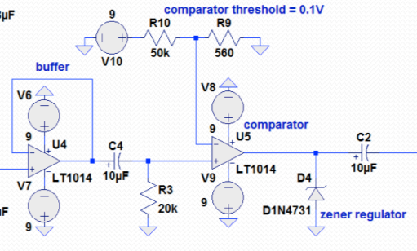
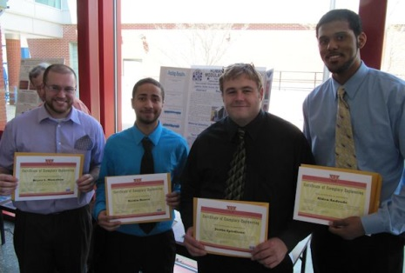
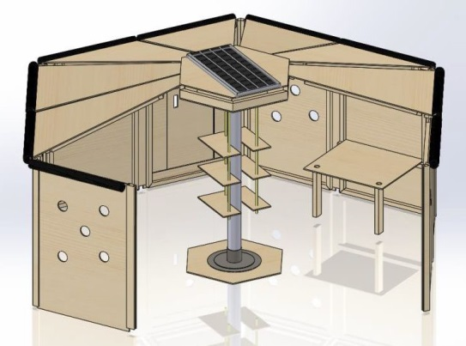
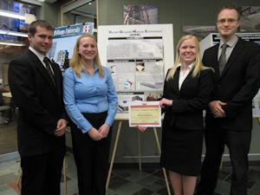
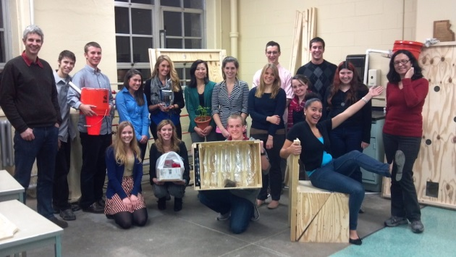
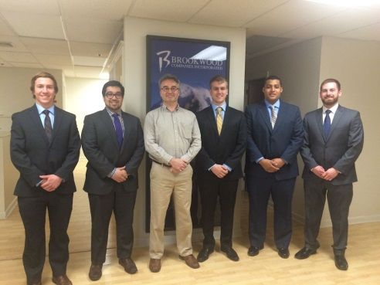
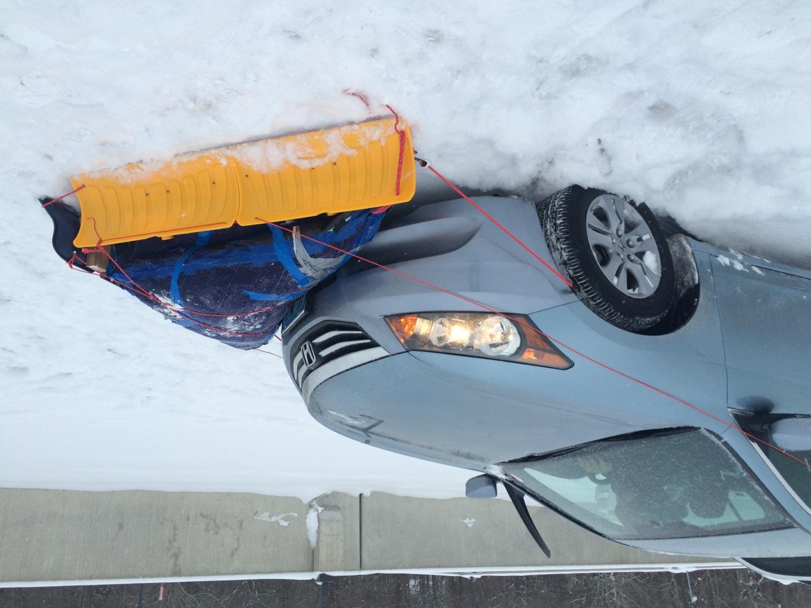
Capstone projects I’ve sponsored
HOME Shelter
URI
CircuiTree
RWU
RWU
URI
InstaPlow
RWU
Notes:
I sponsor Capstone Projects at URI and RWU. Since 2011, I've sponsored 5 College of Engineering projects; the projects are a mix of mechanical and electrical engineering and computer science. Some have won awards at the international level; but all were successful in motivating students to achieve objectives and work in teams. My role is to support the students in systems engineering and problem solving techniques based on my aerospace experience and training.
The HOME Shelter – At RWU in the 2012 ASEE North East Division Conference, the Senior Design Team won 1st place in the poster section and 3rd place overall in the undergraduate division against Yale, Olin and others. Plus, 1st place in RWU Academic Showcase. At URI in 2013, a team of 16 Honors Class university students in HPR “Designing Sustainable Solutions for Developing Communities’ chose the HOME Shelter as their class project. They chose to research and build prototypes of selected subsystems to test compliance to requirements.
CircuiTree – In 2014, the RWU CircuiTree Decay Detector won 2nd place in the Open Category at the NMSU WERC Institute for Energy and the Environment and 1st place in the Peer Award category.

Slide 19
What I do as a Sponsor
Assist developing system and detail requirements.
Assist writing a System Specification, if required.
Attend any team meetings.
Offer advice on systems engineering, analytic tools, methods, metrics, progress, etc.
Review any reports.
Conduct reviews
Requirements, concept and design
Notes:
I work with the team of students by defining some high level requirements, maybe 5 – 10 requirements that we track throughout the project. Each high level system requirement might be broken down into lower level requirements. For instance, if I suggest that we use coding to indicate severity, then I would point students to population stereotypes of color, line, and shape coding elements of the display to attract user attention. I attend most meetings either face to face or FaceTime. FaceTime is very effective and inexpensive compared to driving back and forth to Bristol once a week or every couple of weeks. I review any reports and offer suggestions on how to improve content or flow of the report.

Slide 20
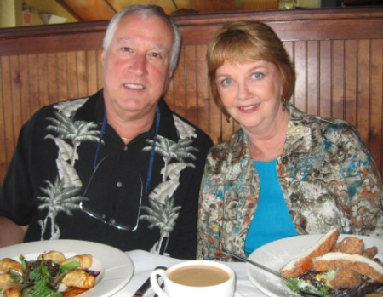
My Background
BA (Psychology, Biology), URI, 1971.
MA (Engineering Psychology), NMSU, 1974.
Senior Staff Human Factors and Systems Engineer, Lockheed Martin, Sunnyvale, CA, 1974-2007.
Applied human factors engineering principles and design standards to mobile shelters, large facilities, missiles, ships, planes, spacecraft, command centers, equipment racks and consoles, transportation systems, handling fixtures, railcars, support equipment, and computer human interfaces.
Worked with mechanical and electrical engineering, systems engineering, manufacturing, training, logistics, parts, materials and processes, facility and field engineering and DOD customers and suppliers.
Taught Specialty Engineering, CONOPS, HFE classes.
Certified Human Factors Engineer #529.
Retired 2007 after 33 years in aerospace industry.
Married Julie Yingling (URI 1970) September 2008.
Moved to West Kingston, November 2008.
Rick and Julie at Turtle Soup.
Notes:
I started out in the URI College of Engineering but couldn’t quite understand all those forces and vectors in statics and dynamics. I passed slide rule and math but I flunked statics and decided engineering wasn’t my calling. I was graduated in 1971 with majors in psychology and biology, and minors in stat and speech and hearing. Al Lott recommended I get a graduate degree at NMSU because it was far away from home, had a low student/faculty ratio, and the profs were from great universities. So I tried ‘engineering psychology’ which focuses on understanding the capabilities and limitations of humans and applying that knowledge to the design of equipment, user interfaces, and facilities so they are easy to use. In 1974, I got a job at Lockheed in Sunnyvale, CA and stayed there until 2007. I worked on ships, planes, communication centers, missiles, spacecraft, submarines, health care delivery systems and other things that ‘go bump in the night’. Never a dull moment except between jobs when you’re looking for new work which was pretty often…. I retired in 2007, got married in 2008, and looked for a place to retire. Which turned out to be Rhode Island which is pretty amazing because most people leave RI and don’t retire here. But it’s worked out very well.

